Slide 1


Slide 2

Ambulance Booking System

Slide 3
Group Members Introduction
Submitted By
S240262570
MUHAMMAD Bilal Yousaf
BC200405410

Slide 4

INTRODUCTION OF PROJECT
My project is “Ambulance Booking System”.
Medical emergencies often require immediate action, and timely transportation to a hospital can mean the difference between life and death. The Abundance Booking System (ABS) is a web-based application designed to streamline the process of booking ambulances during critical situations. By enabling users to register and quickly access services, ABS ensures that patients are transported efficiently to nearby hospitals, even during challenging times such as peak traffic hours or late at night.
This system integrates key features such as personalized recommendations based on the patient’s condition, a list of nearby hospitals and specialists, and the ability to manage transportation details. It also allows administrators to monitor operations, generate detailed reports, and enhance service efficiency. With ABS, both users and service providers can benefit from a more organized and responsive approach to emergency healthcare logistics.

Slide 5
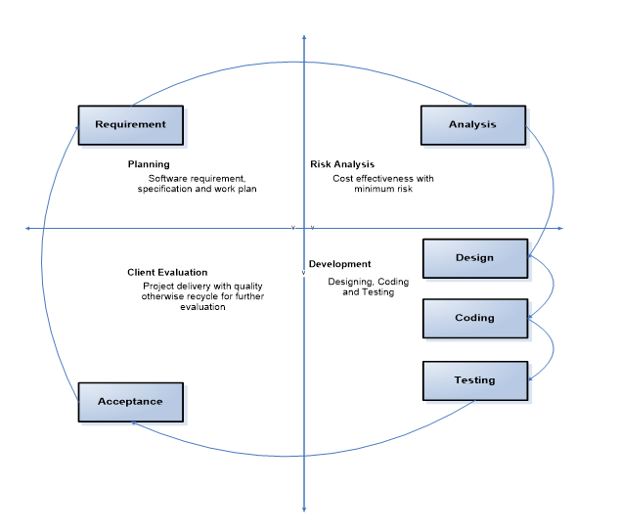
VU PROCESS MODEL

Slide 6
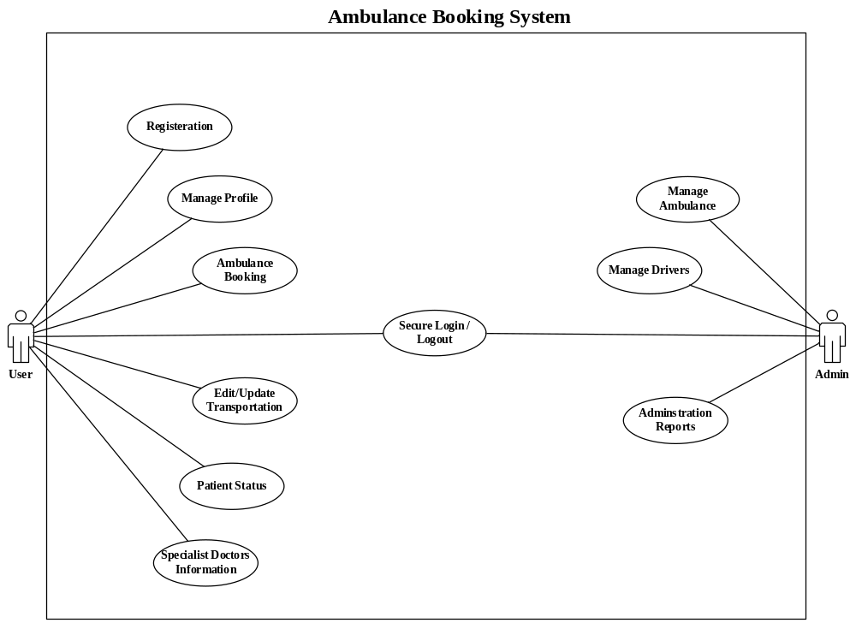
Use Case Diagram

Slide 7
Business Rules Catalog
Modules:
In this project we have two following Modules.
Admin Module
User Module

Slide 8
Business Rules Catalog
Admin Module:
Login: Admin can login in to system.
Administration Reporting:
Administrators should be able to generate various reports, such as weekly transportation reports, monthly transportation reports, and area-wise transportation reports.
These reports aid in analyzing system performance and resource management.
Ambulance and Driver Data Management
The system should store detailed information about ambulances, including their size, number, and availability.
It should also maintain data about ambulance drivers, ensuring efficient dispatch and management of resources.

Slide 9
Business Rules Catalog
User Module:
Secure Login:
There must be a secure login process for users and administrators to access the application, ensuring data security and privacy.
User Registration:
Users must be able to register themselves by providing necessary personal details such as name, contact information, and address.
Profile Management:
Users should be able to edit and update their profiles, ensuring their information is accurate and up-to-date.
Ambulance Booking:
Users must be able to book an ambulance by providing details such as the pick-up point, destination (hospital name), date, and time.
While booking, users should be provided with a list of the nearest hospitals to choose from.

Slide 10
Business Rules Catalog
User Module:
Edit/Update Transportation Details:
Users should be able to edit and update their transportation details, such as changing the pick-up point or destination.
Patient Status Input:
Users should be able to specify the patient’s status, including type of injury or disease.
The system should recommend the nearest hospital based on the patient’s condition, ensuring appropriate medical care.
Specialist Doctors Information:
The system should maintain a list of specialist doctors, including their locations and availability (duty times).
This information helps in directing patients to the right medical experts promptly.

Slide 11
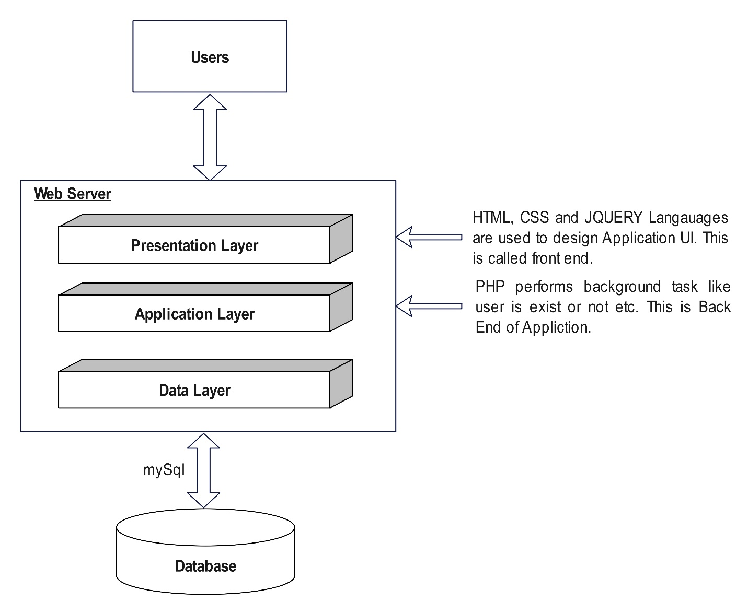
Architectural Design

Slide 12
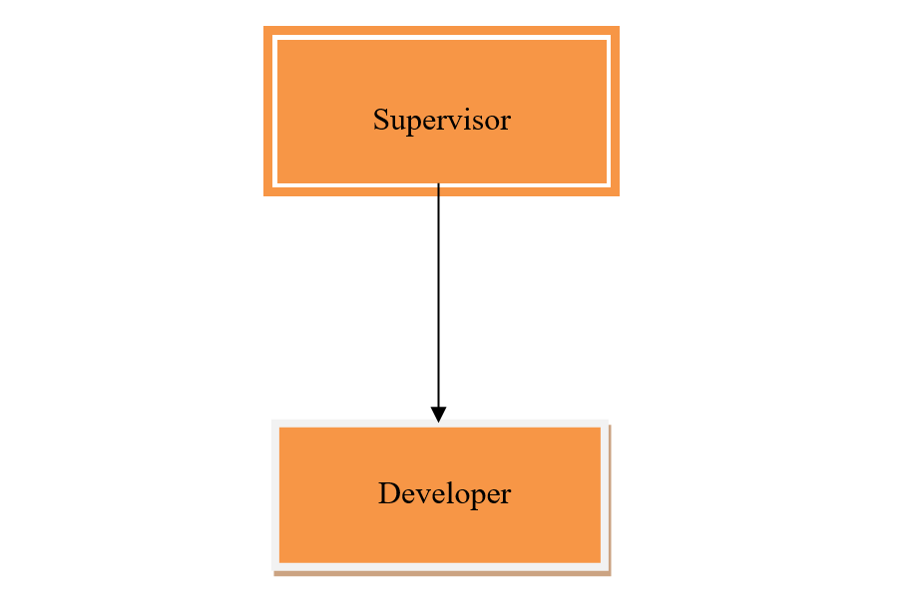
Team Structure

Slide 13
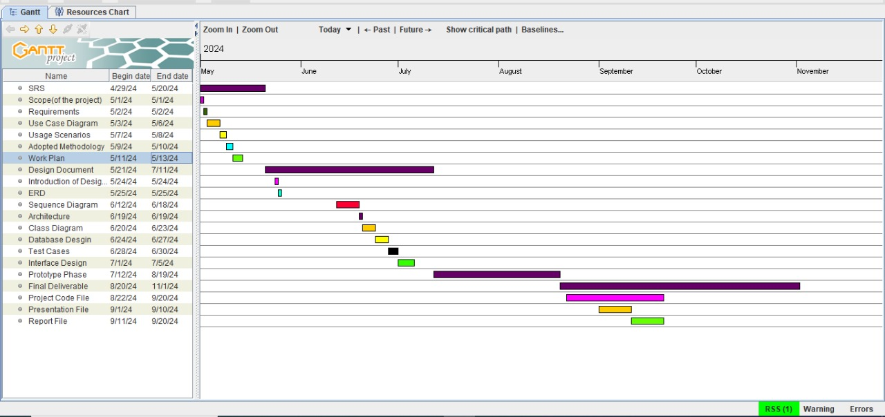
Project Schedule

Slide 14
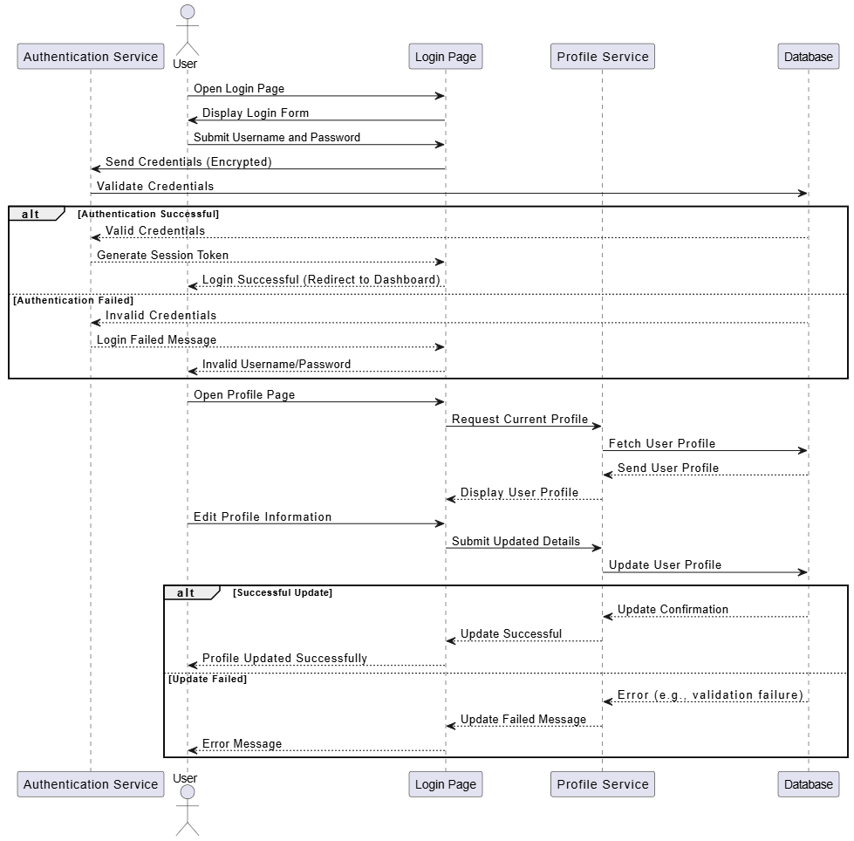
Sequence Diagrams
Secure Login

Slide 15
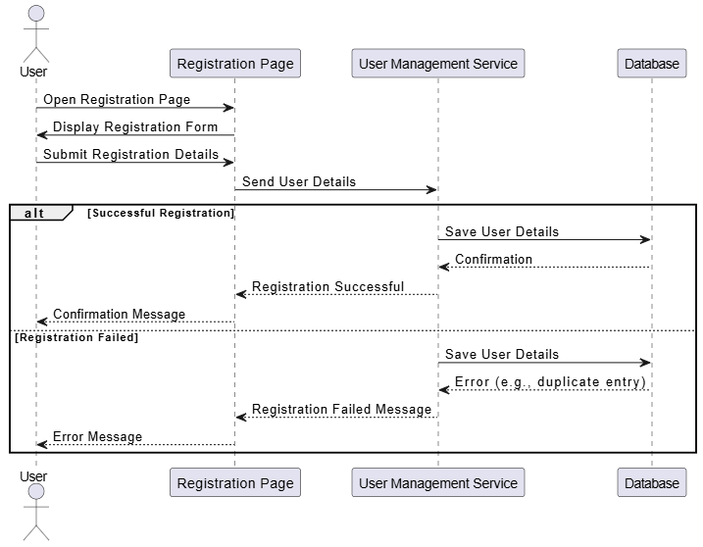
Sequence Diagrams
User Registration

Slide 16
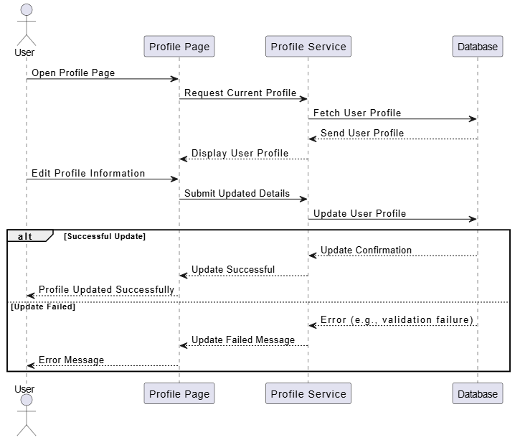
Sequence Diagrams
Manage Profile

Slide 17
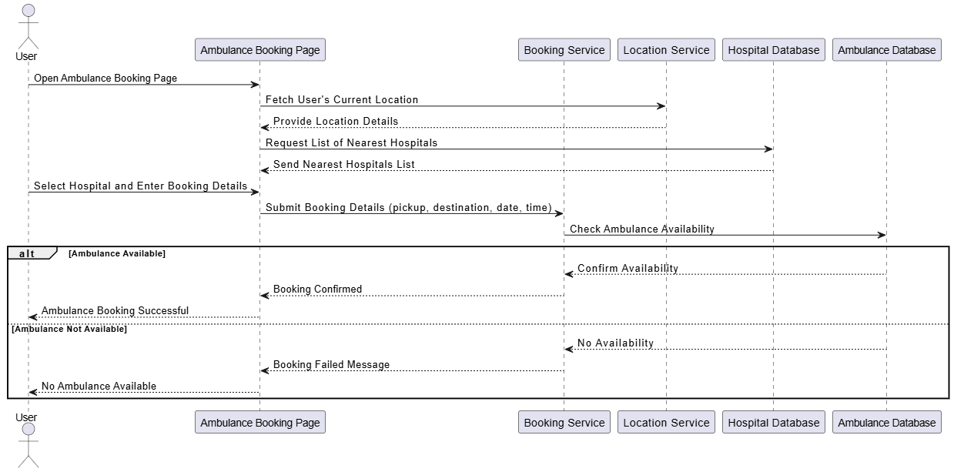
Sequence Diagrams
Ambulance Booking

Slide 18
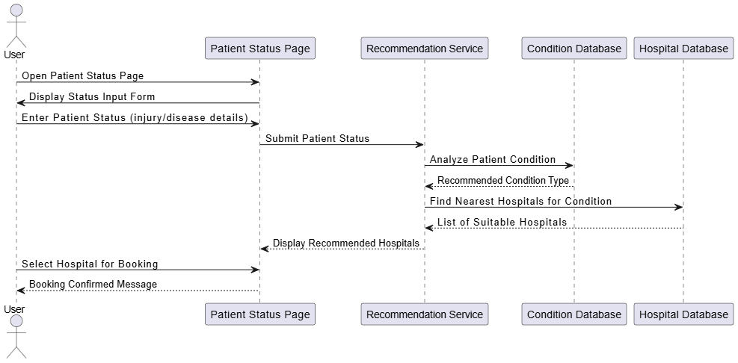
Sequence Diagrams
Patient Status

Slide 19
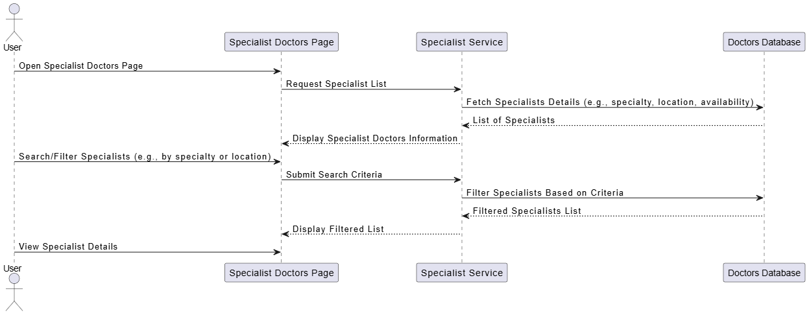
Sequence Diagrams
Specialist Doctors Information

Slide 20
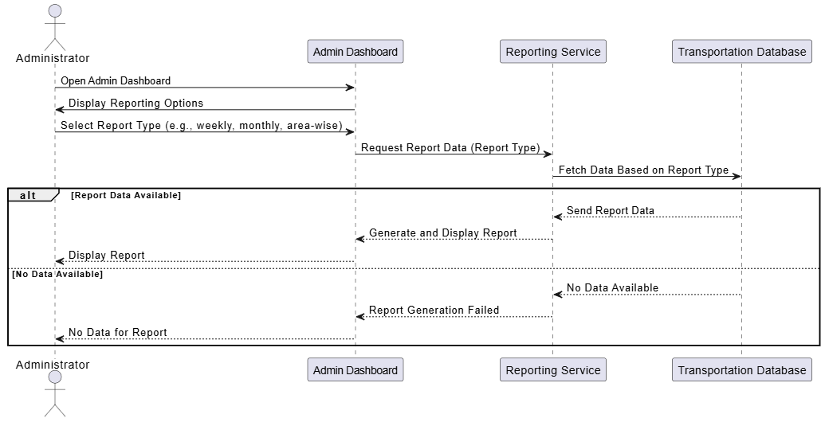
Sequence Diagrams
Administration Reporting

Slide 21
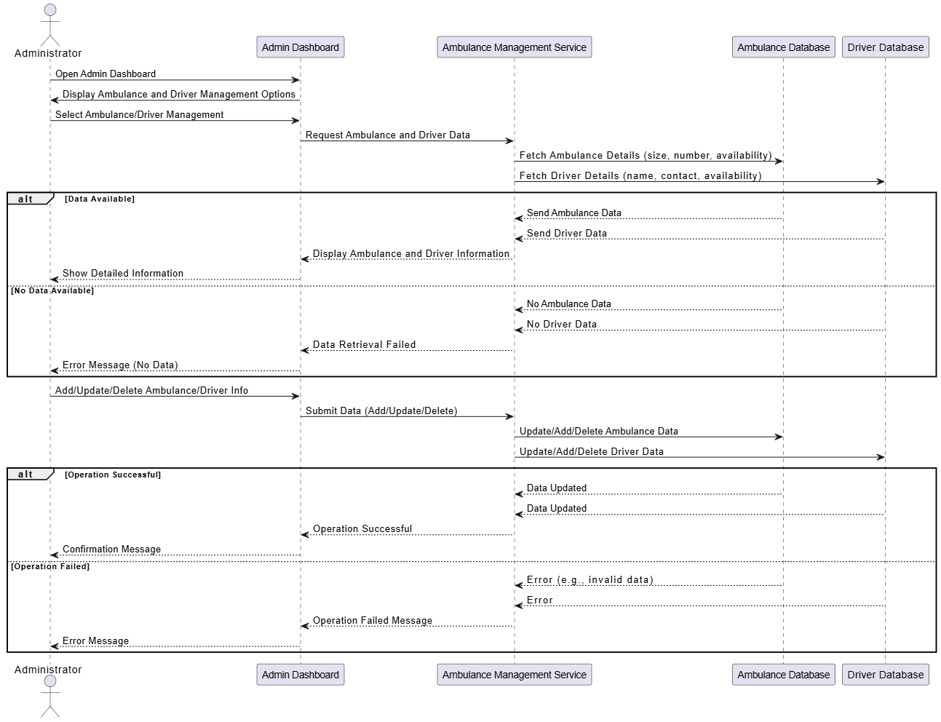
Sequence Diagrams
Ambulance & Driver Manage

Slide 22
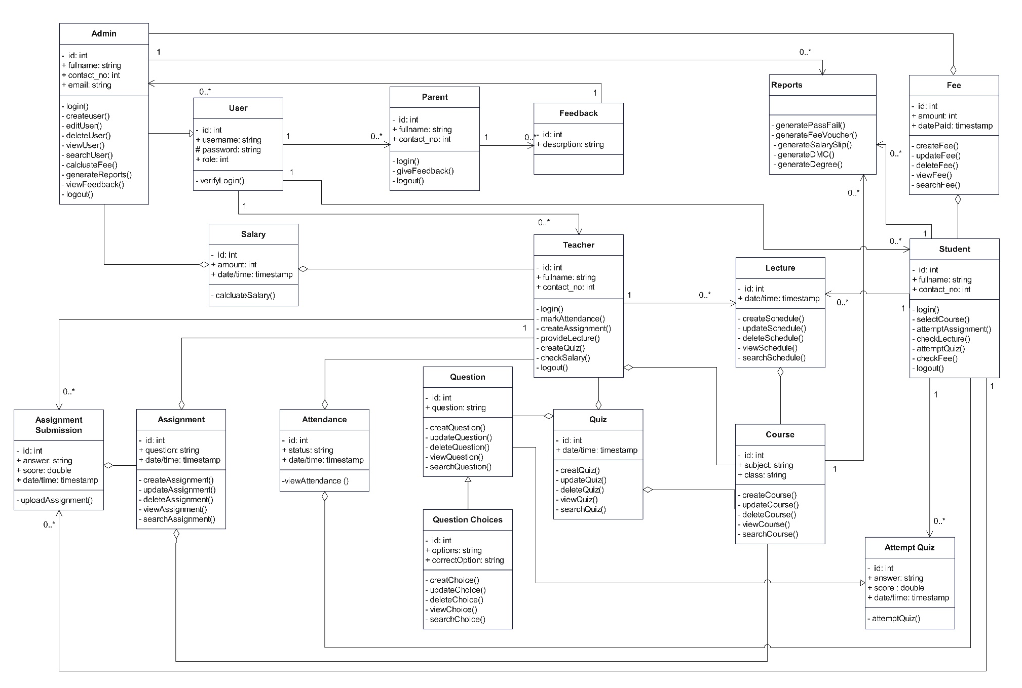
Logical Model/Class Diagram

Slide 23
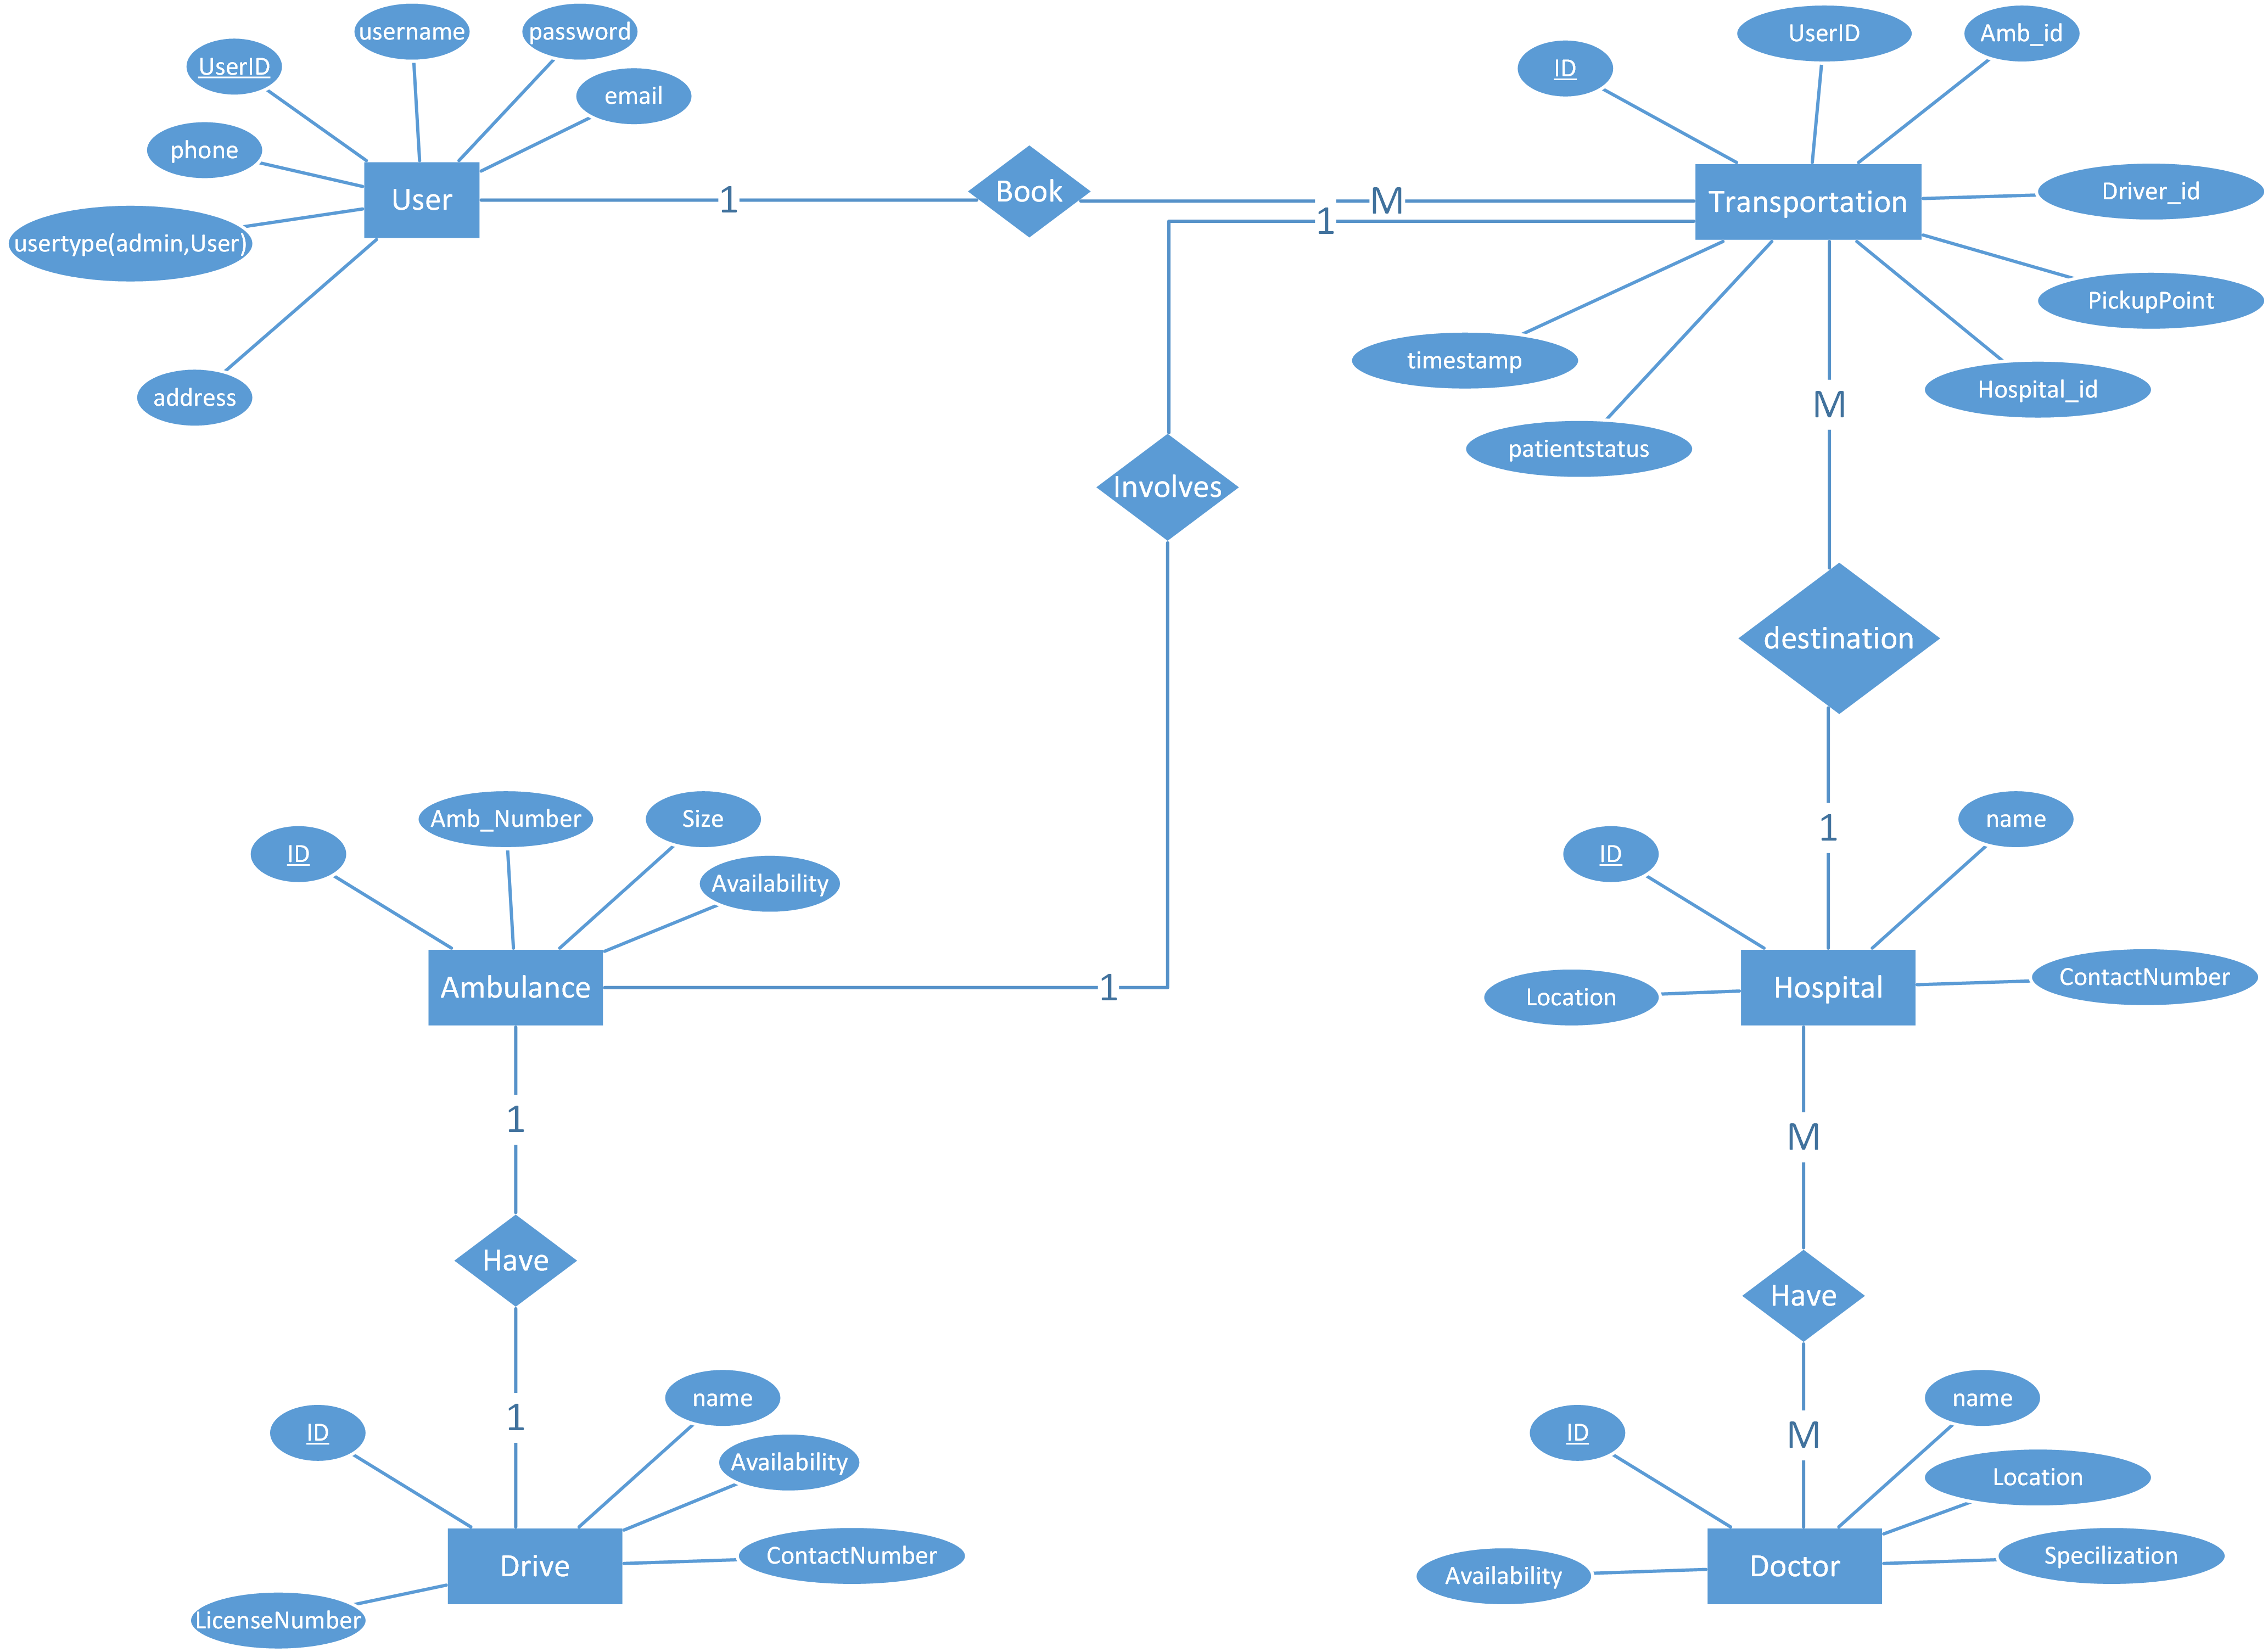
Entity-Relationship Diagram

Slide 24
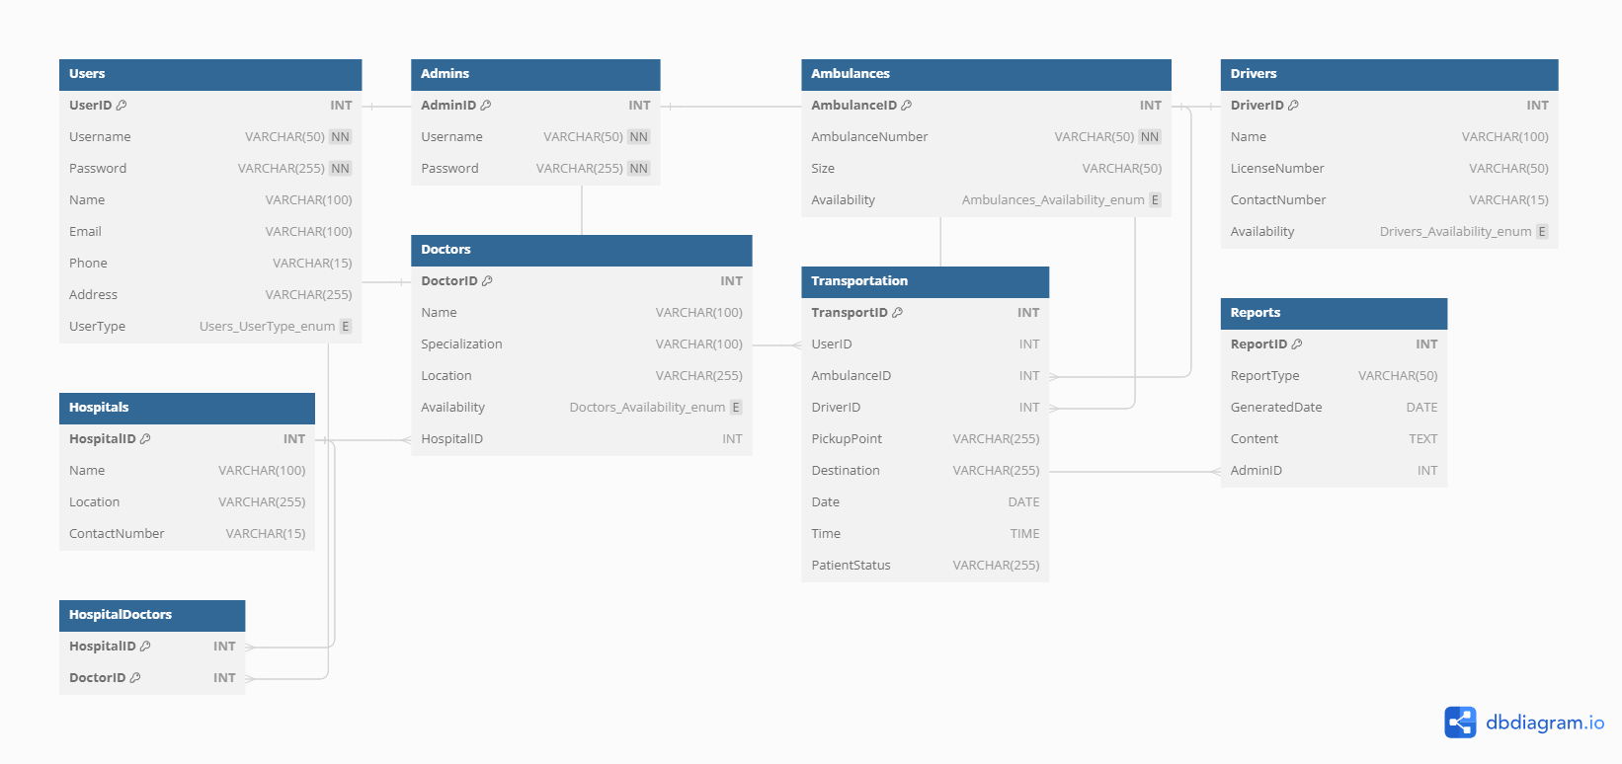
Database Diagram

Slide 25
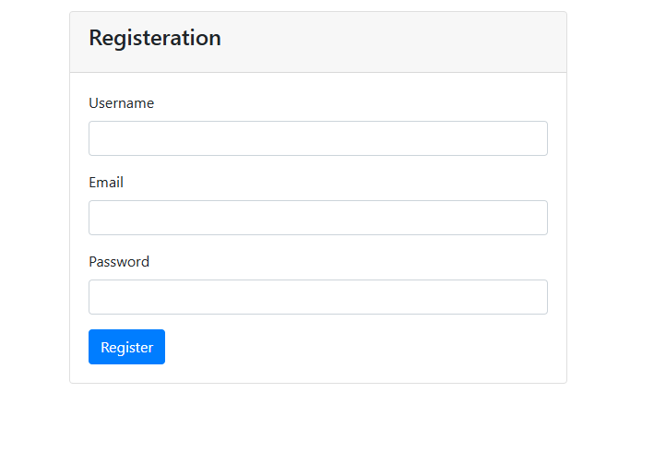
User Interfaces
Registration Page

Slide 26
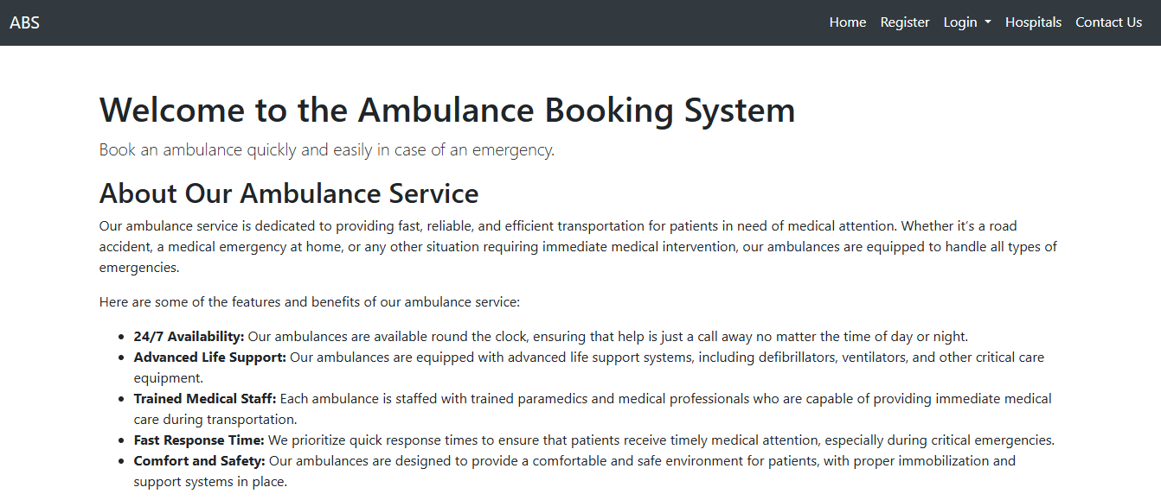
User Interfaces
Welcome Page

Slide 27
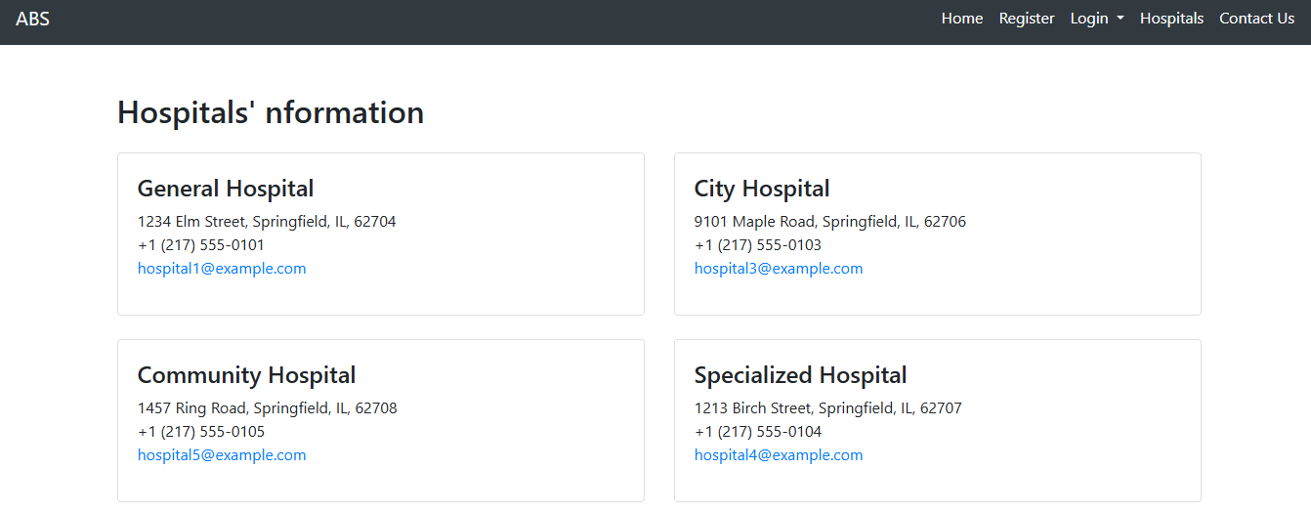
User Interfaces
Information of Hosptials

Slide 28
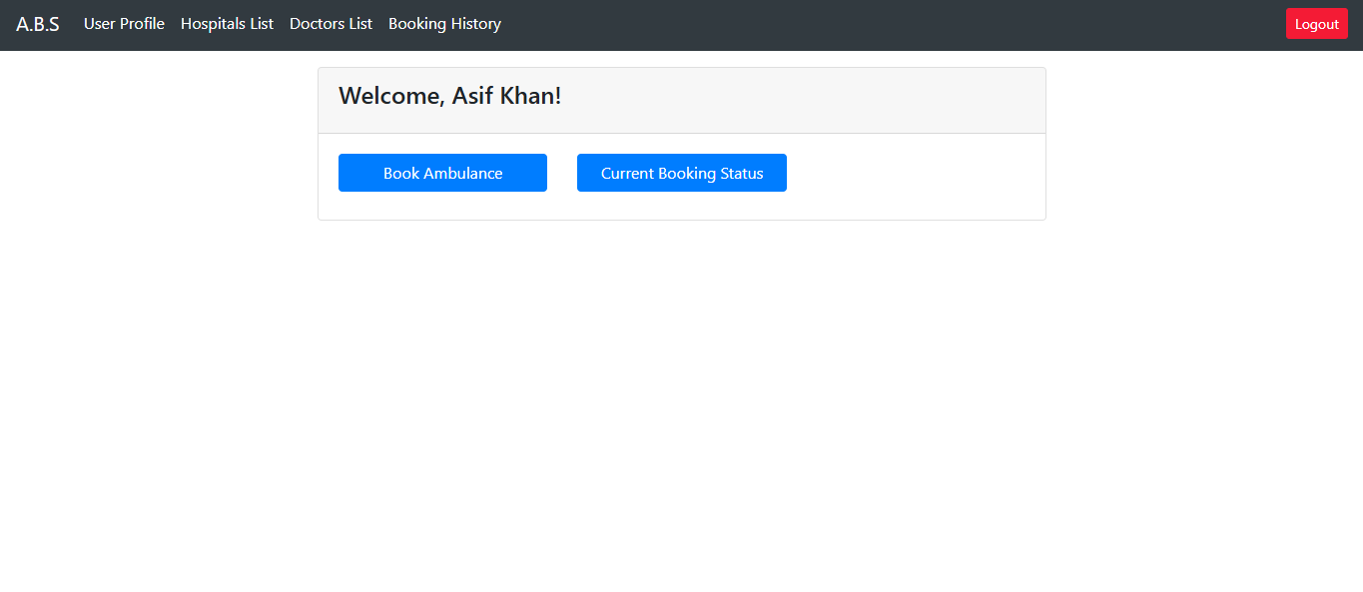
User Interfaces
Admin Home Page

Slide 29
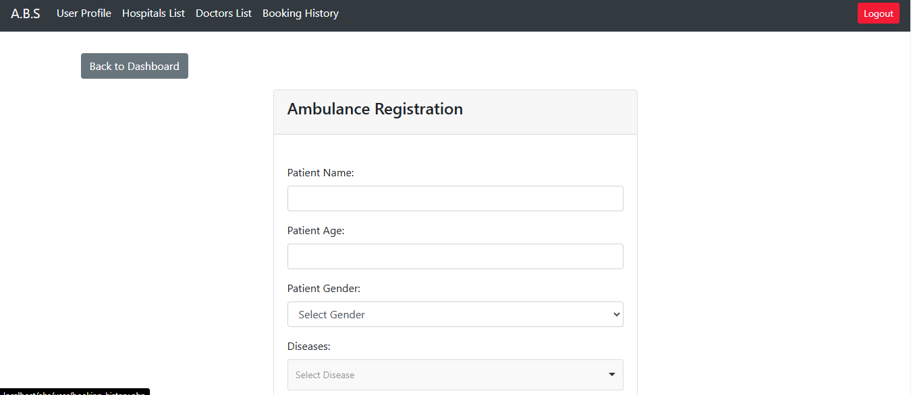
User Interfaces
Ambulance Booking Page

Slide 30
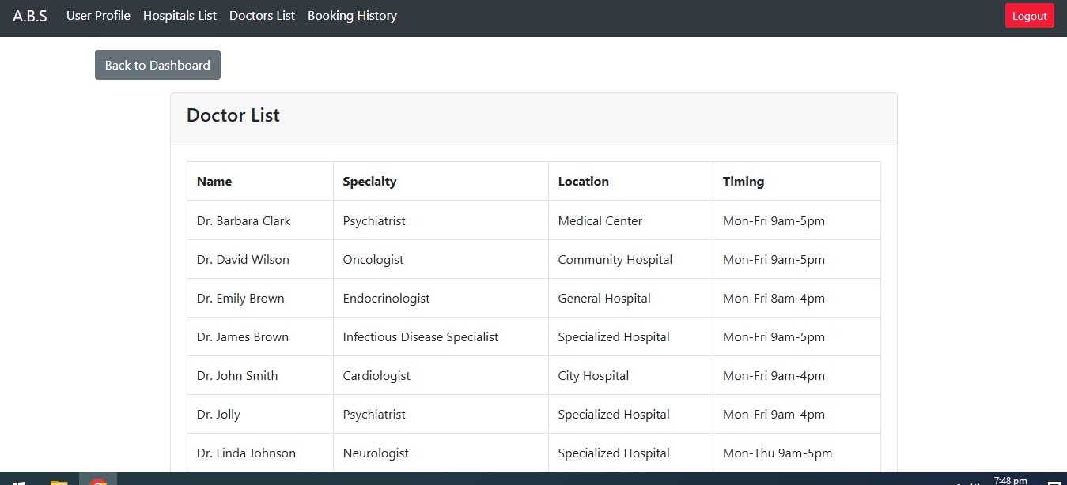
User Interfaces
Doctors List Page

Slide 31
Tools
Tools:
PHP, HTML, CSS, JS, MySql
Software:
Editor: Sublime/Netbeans/Any editor supports web development
Server: Xaxmpp/ Wampp

Slide 32
THANKYOU

